Slide 1
5. Audio coding standards
Xavier Serra

Slide 2
Index
MIDI format
Mono, Stereo and Surround Sound formats
MPEG audio standards
MPEG-1 Layer 3 (MP3)
MPEG-2 Advanced Audio Coding (AAC)
MPEG-4
Dolby Digital (AC3)
Lossless audio coding

Slide 3
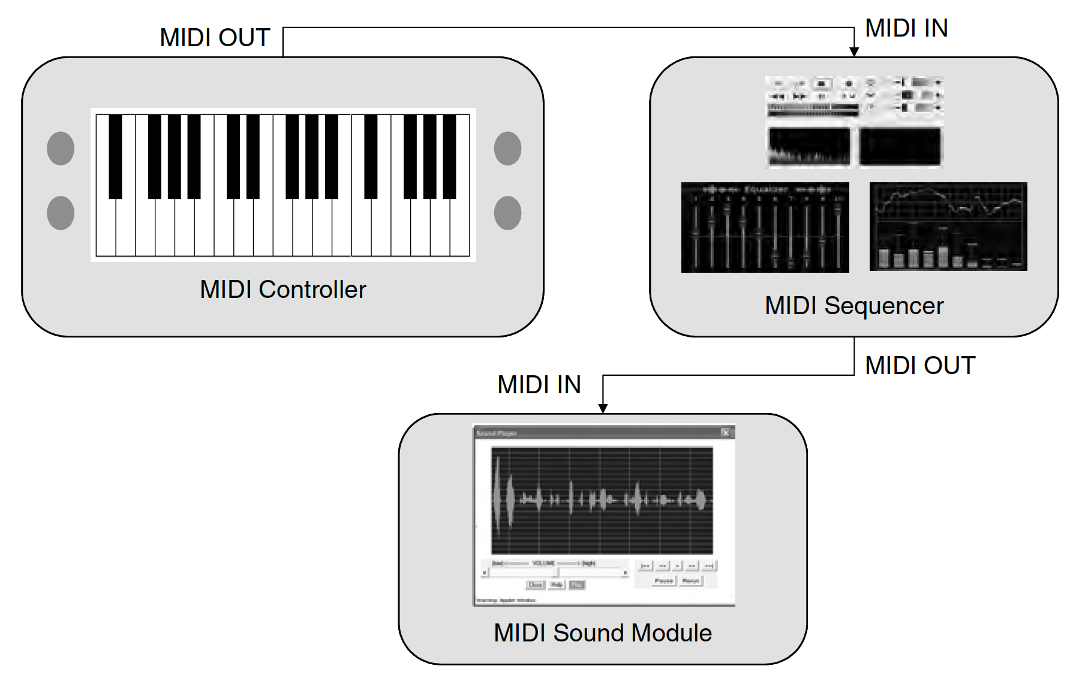
MIDI

Slide 4
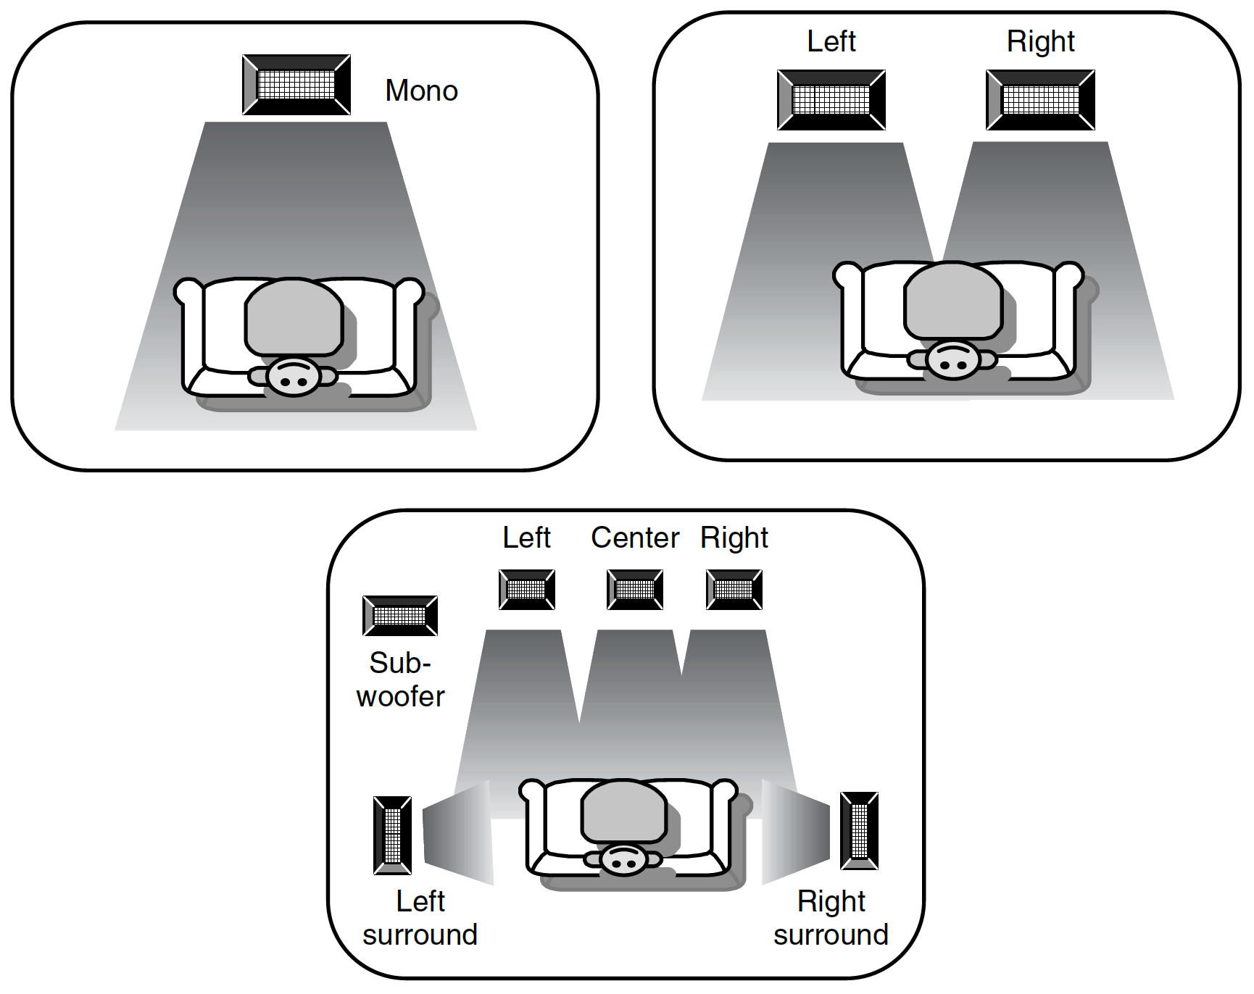
Mono, Stereo, Surround

Slide 5
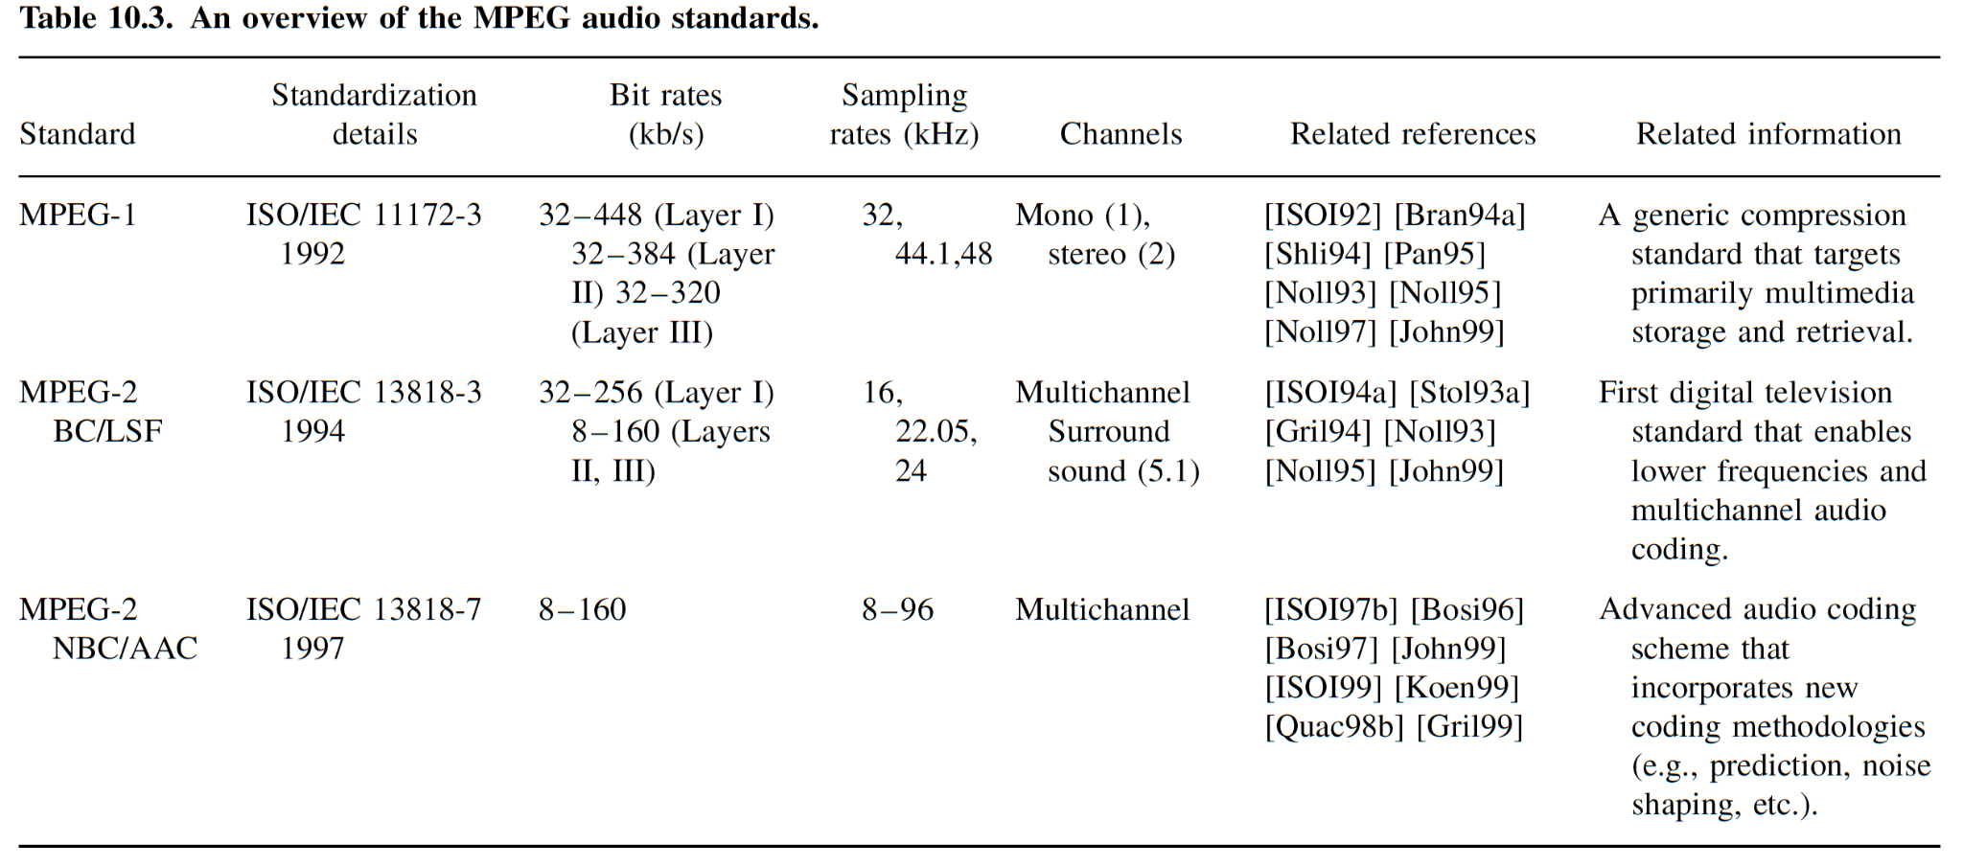
MPEG audio standards
MPEG is the acronym for Moving Pictures Experts Group.
MPEG standardizes the type of information that an encoder has to produce as well as the way in which the decoder has to decompress the information.

Slide 6
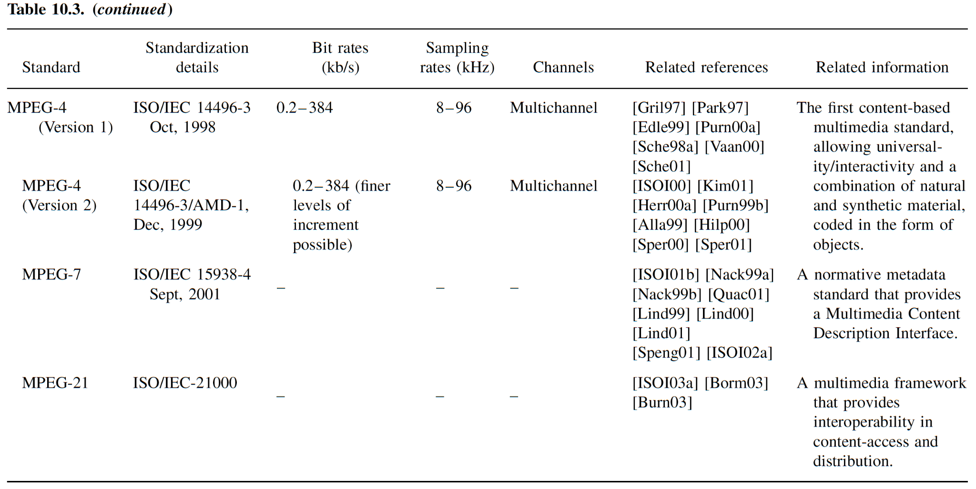

Slide 7
MPEG-1 Audio
Lossy compression of mono and stereo signals.
Sampling frequency: 32KHz, 44.1 KHz, 48 KHz.
Precision 16 bits.
3 compression layers: Layer 1, Layer 2, Layer 3.
Layer 1: 32-448 kbps, target 192 kbps
Layer 2: 32-384 kbps, target 128 kbps
Layer 3: 32-320 kbps, target 64 kbps
Layer 3 is called MP3 format.
Popular for Internet applications

Slide 8
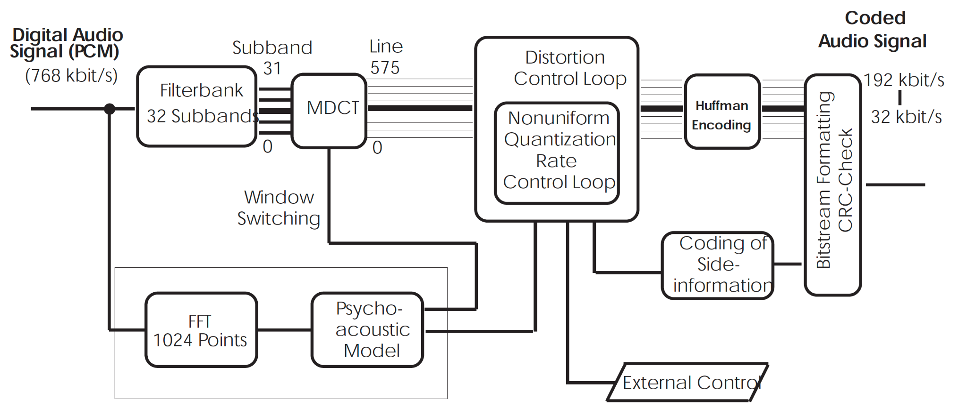
MP3 encoder

Slide 9
Filter bank: Hybrid filter bank. Polyphase filterbank (as used in Layer-1 and Layer2) followed by a Modified Discrete Cosine Transform (MDCT).
Perceptual model to identify masking thresholds based on critical bands of human hearing and using the FFT.
Quantization and coding: Two nested iteration loops. Use of Huffman coding.

Slide 10
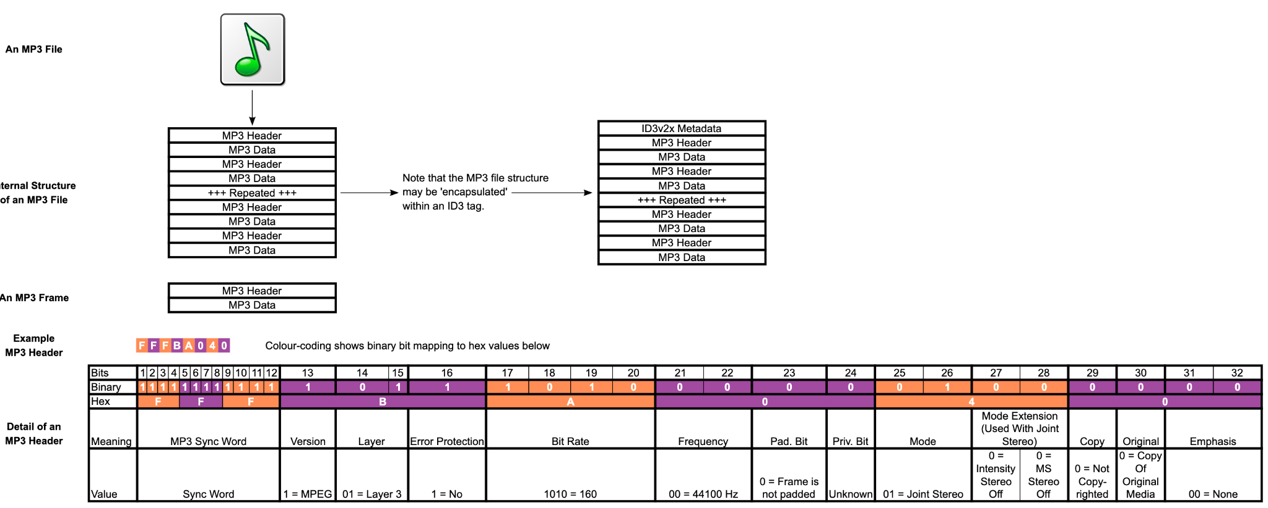
MP3 audio format

Slide 11
MPEG-2 Advanced Audio Coding (AAC)
Supports up to 5.1 channels.
AAC follows the same basic coding paradigm as Layer-3 (high frequency resolution filterbank, non-uniform quantization, Huffman coding, iteration loop structure using analysis-by-synthesis), but improves on Layer-3 in a lot of details and uses new coding tools for improved quality at low bitrates.
Higher frequency resolution (1024 frequency lines)
Improved joint stereo coding
Improved Huffman coding
Enhanced block switching
…

Slide 12
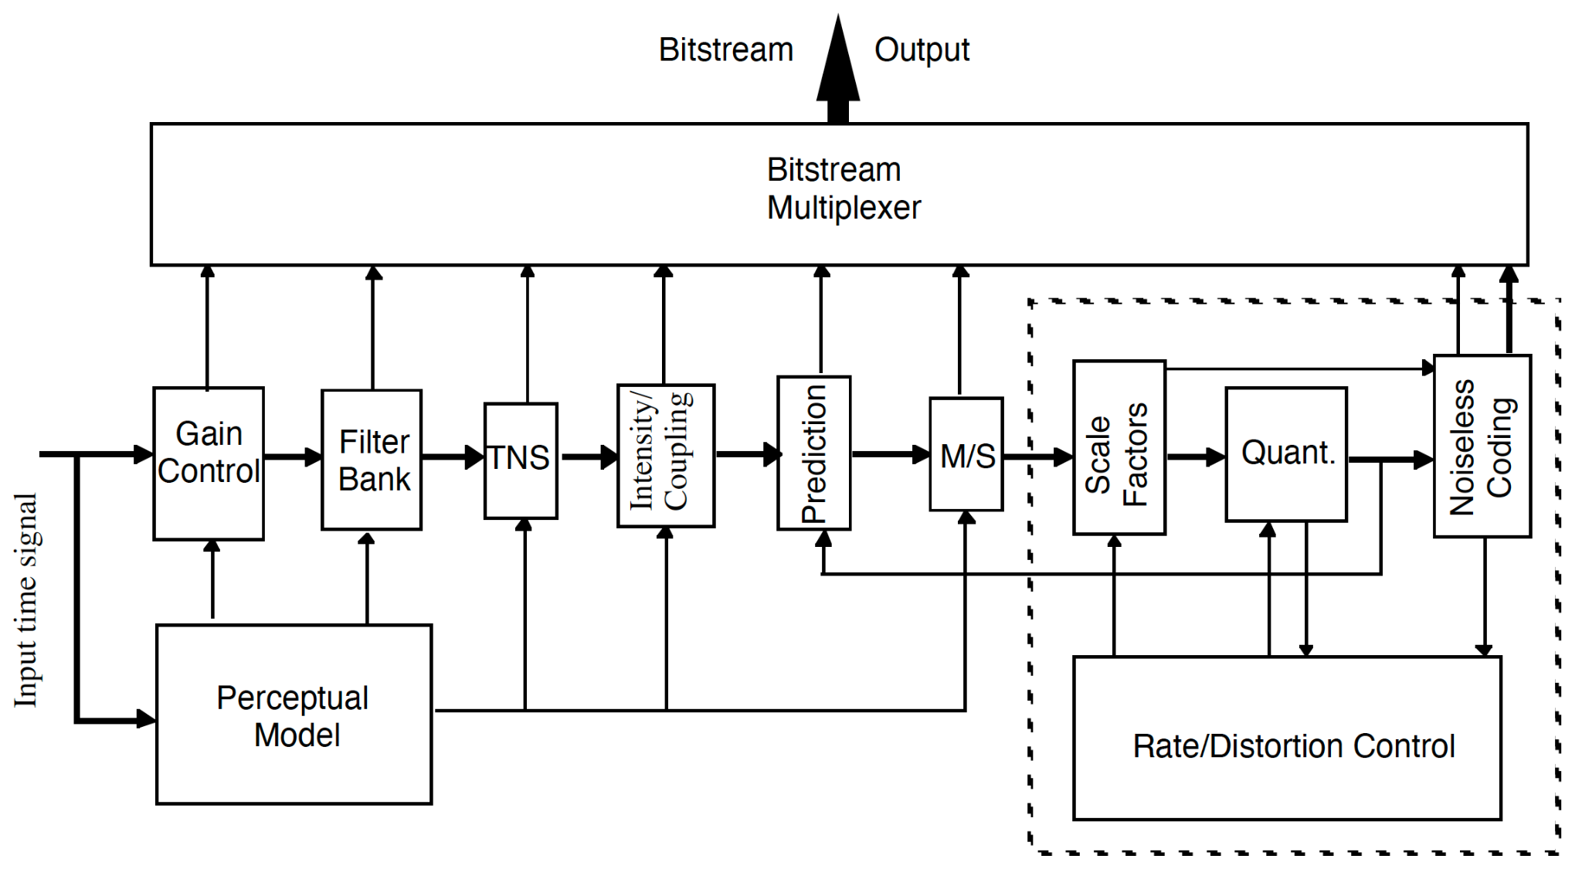
AAC encoding

Slide 13
Temporal noise shaping (TNS) tool helps to control temporal shape of quantization noise.
Intensity coding and the coupling reduces perceptually irrelevant information by combining multiple channels in high-frequency regions into a single channel.
Prediction tool further removes redundancies between adjacent frames.
M/S coding removes stereo redundancy based on coding the sum and difference signal instead of the left and right channels.

Slide 14
MPEG-4 Audio
Extensive scalability and object-based representations.
Variety of applications.
General audio signals
Speech signals
Synthetic audio
Synthesized speech (structured audio)
More sample frequencies (8-96 kHz).
Arbitrary bit rates and variable frame length.
Higher efficiency and simpler filterbank.
Uses pure MDCT (modified discrete cosine transform)
Used in Windows Media Audio

Slide 15
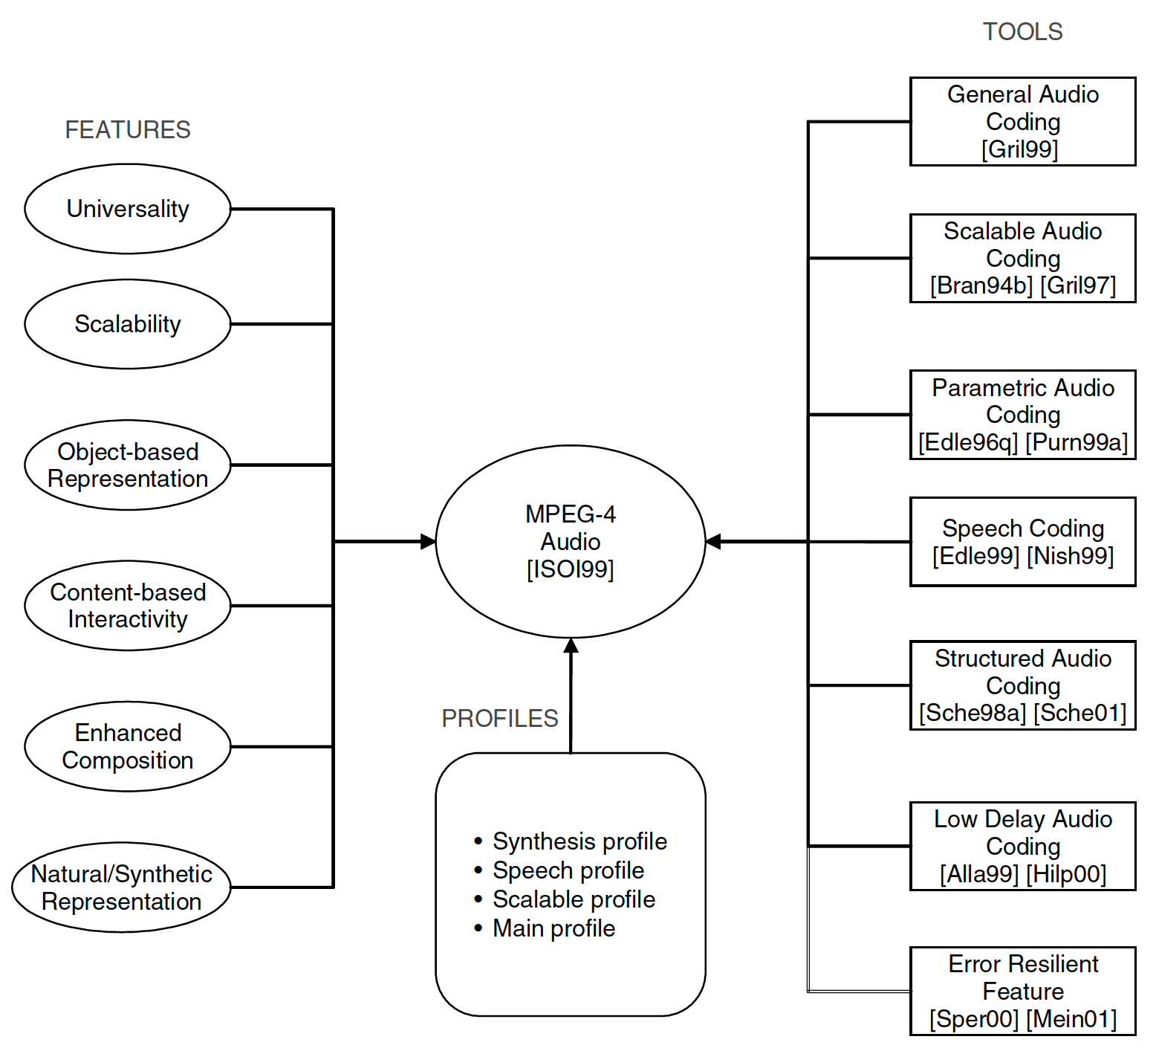

Slide 16
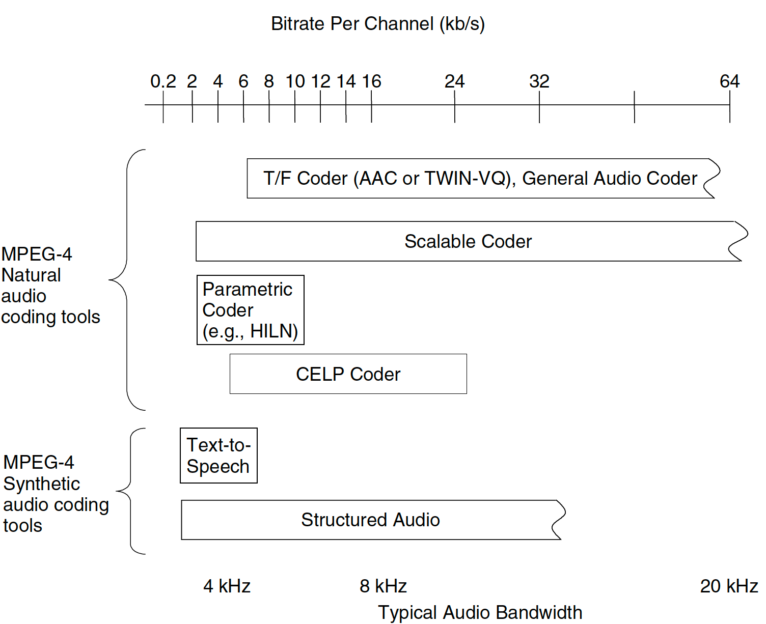
MPEG-4 integrated tools

Slide 17
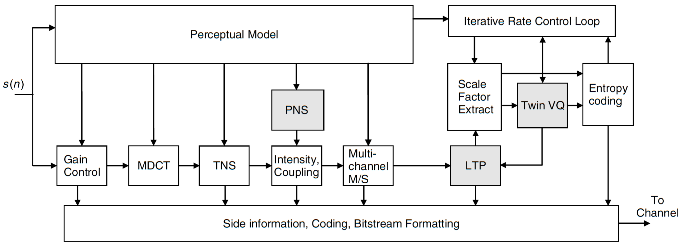
MPEG-4 General Audio coder
Built around MPEG-2 AAC.
Extended features and coder configurations given by the perceptual noise substitution (PNS), long term predictions (LTP), Twin VQ coding, and scalability.

Slide 18
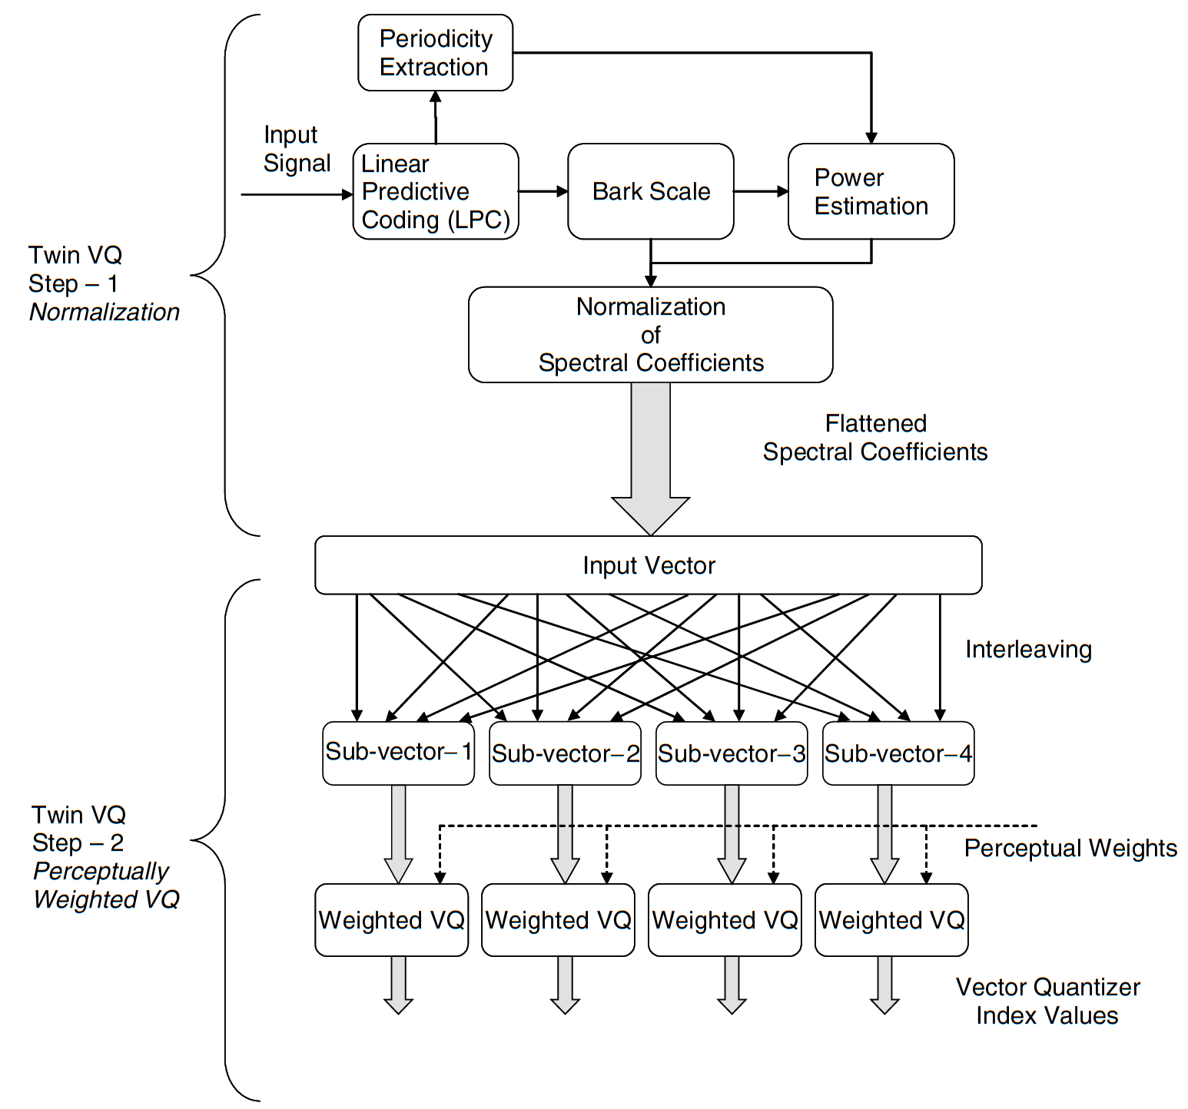
MPEG-4 Twin VQ in GA coder
Transform-domain Weighted Interleave Vector Quantization.
Vector quantization of the transformed spectral coefficients.
Low bit rates (6-8kb/s).

Slide 19
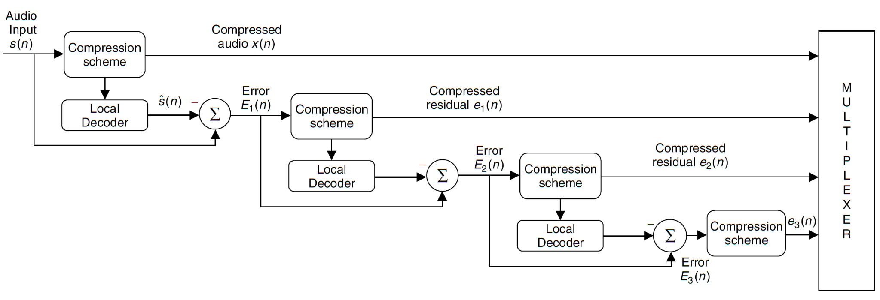
MPEG-4 Scalable audio coding
Variable rate enconding/decoding depending on transmission channel capacity.
Decoding at low bit rates (16, 32, or 64 kb/s within high-rate code (64 kb/s).

Slide 20
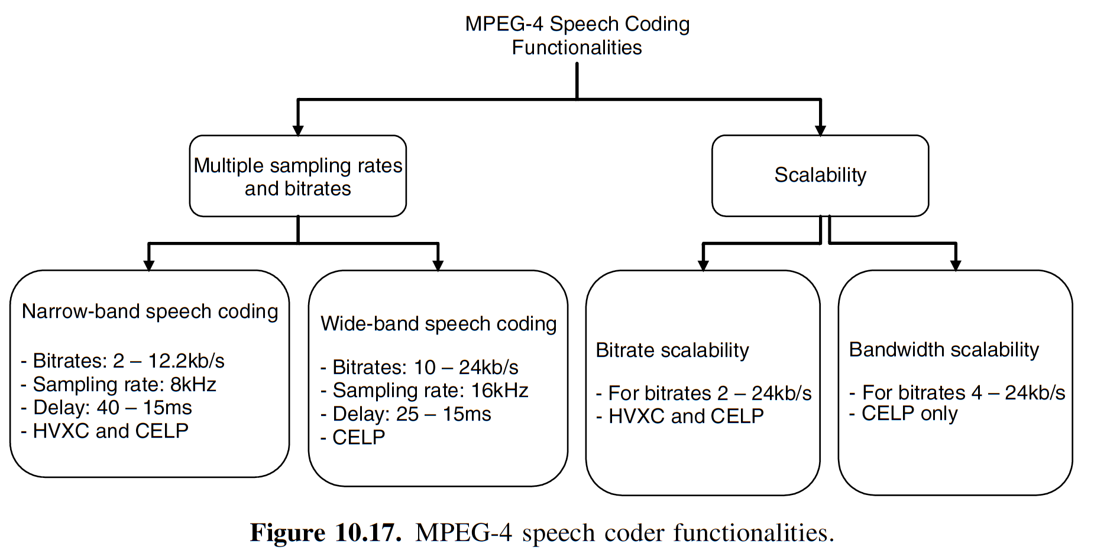
MPEG-4 Speech Coding
Bit rates between 2 kb/s and 24 kb/s.
Based on harmonic vector excitation coding (HVXC) and code excited predictive coding (CELP).

Slide 21
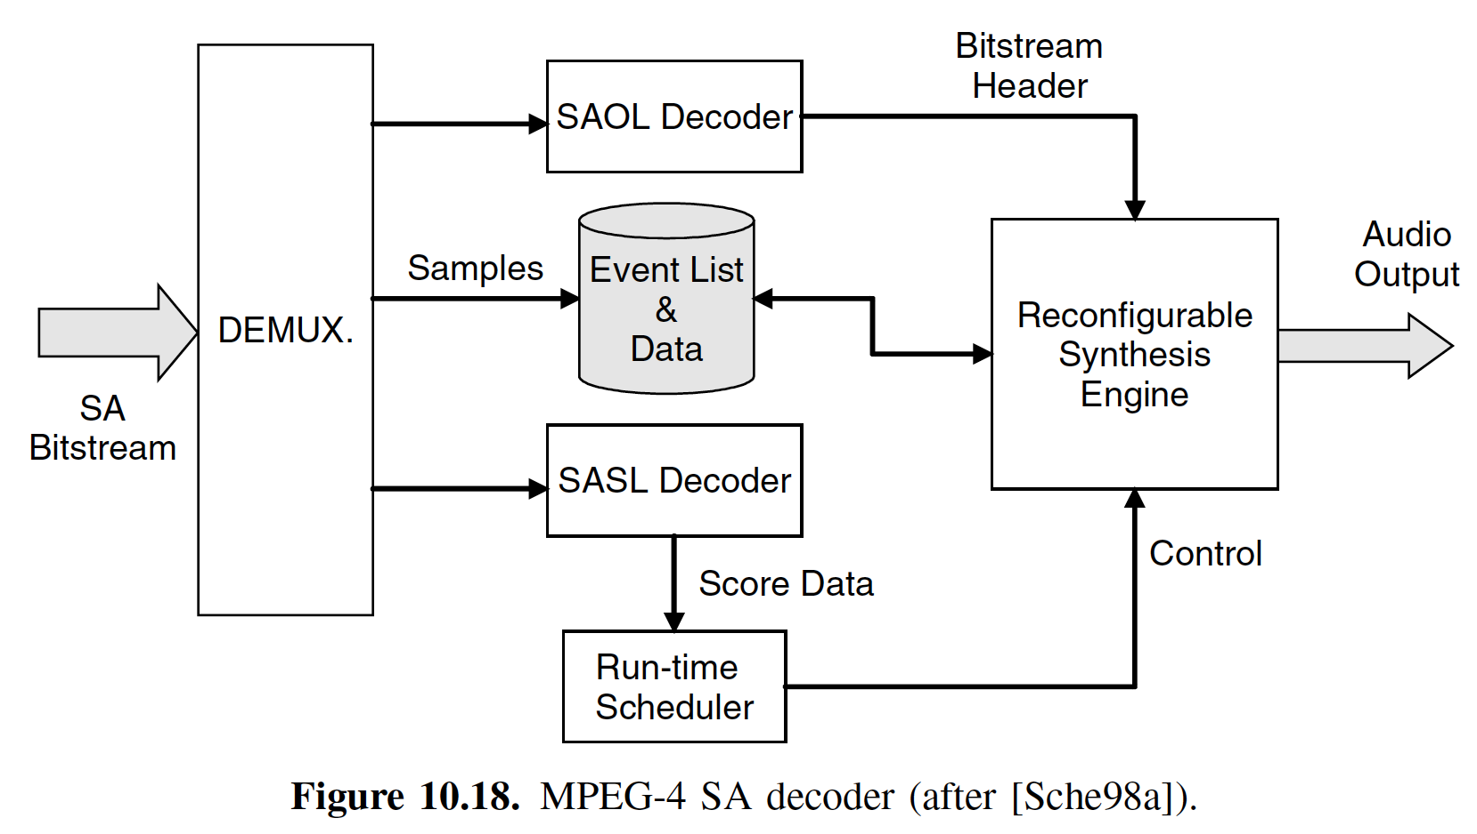
MPEG-4 Structured Audio Coding
Ability to represent and encode efficiently synthetic audio and multimedia content.
Based on the synthesizer-description language called Csound.
Defines a set of syntax and semantic rules corresponding to the Structured Audio orchestra Language (SAOL).

Slide 22
Dolby AC-3 (Dolby Digital)
De factor standard in most movie houses and home theaters.
Sample rates: 32, 44.1, and 48 kHz
Bit rates: 32–640 kb/s, variable
High-quality output at 64 kb/s per channel
Delay roughly 100 ms
MCDT filter bank
Multiple channels processed as an ensemble
Robust decoder downmix functionality from 5.1 to fewer channels

Slide 23
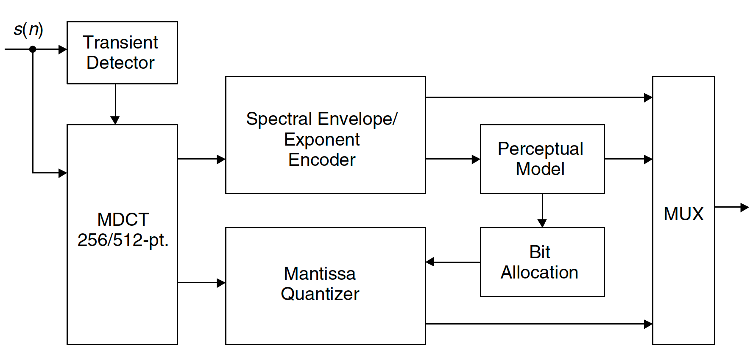
Dolby Digital encoder

Slide 24
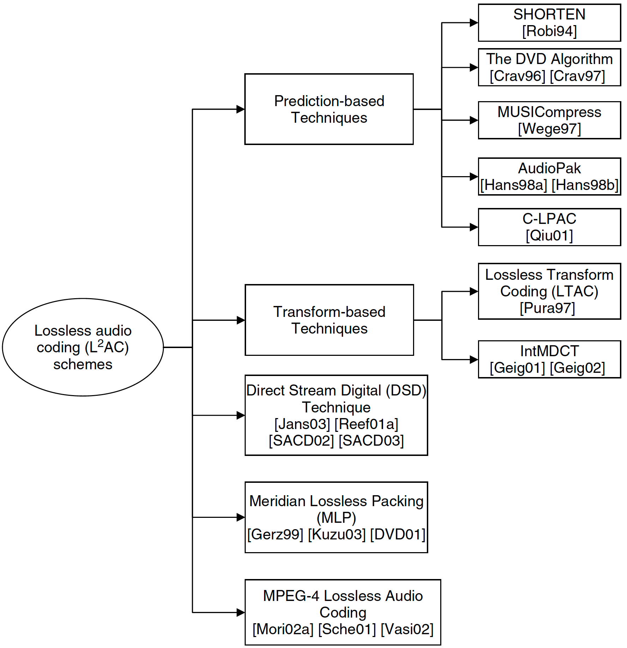
Lossless audio coding algorithms (L²AC)
High-quality audio without any artifacts.
Compression ratios of 2:1 – 4:1.
Not used in real-time and Internet streaming applications.
Employ psychoacoustic principles and time-frequency mapping (not exact replica)

Slide 25
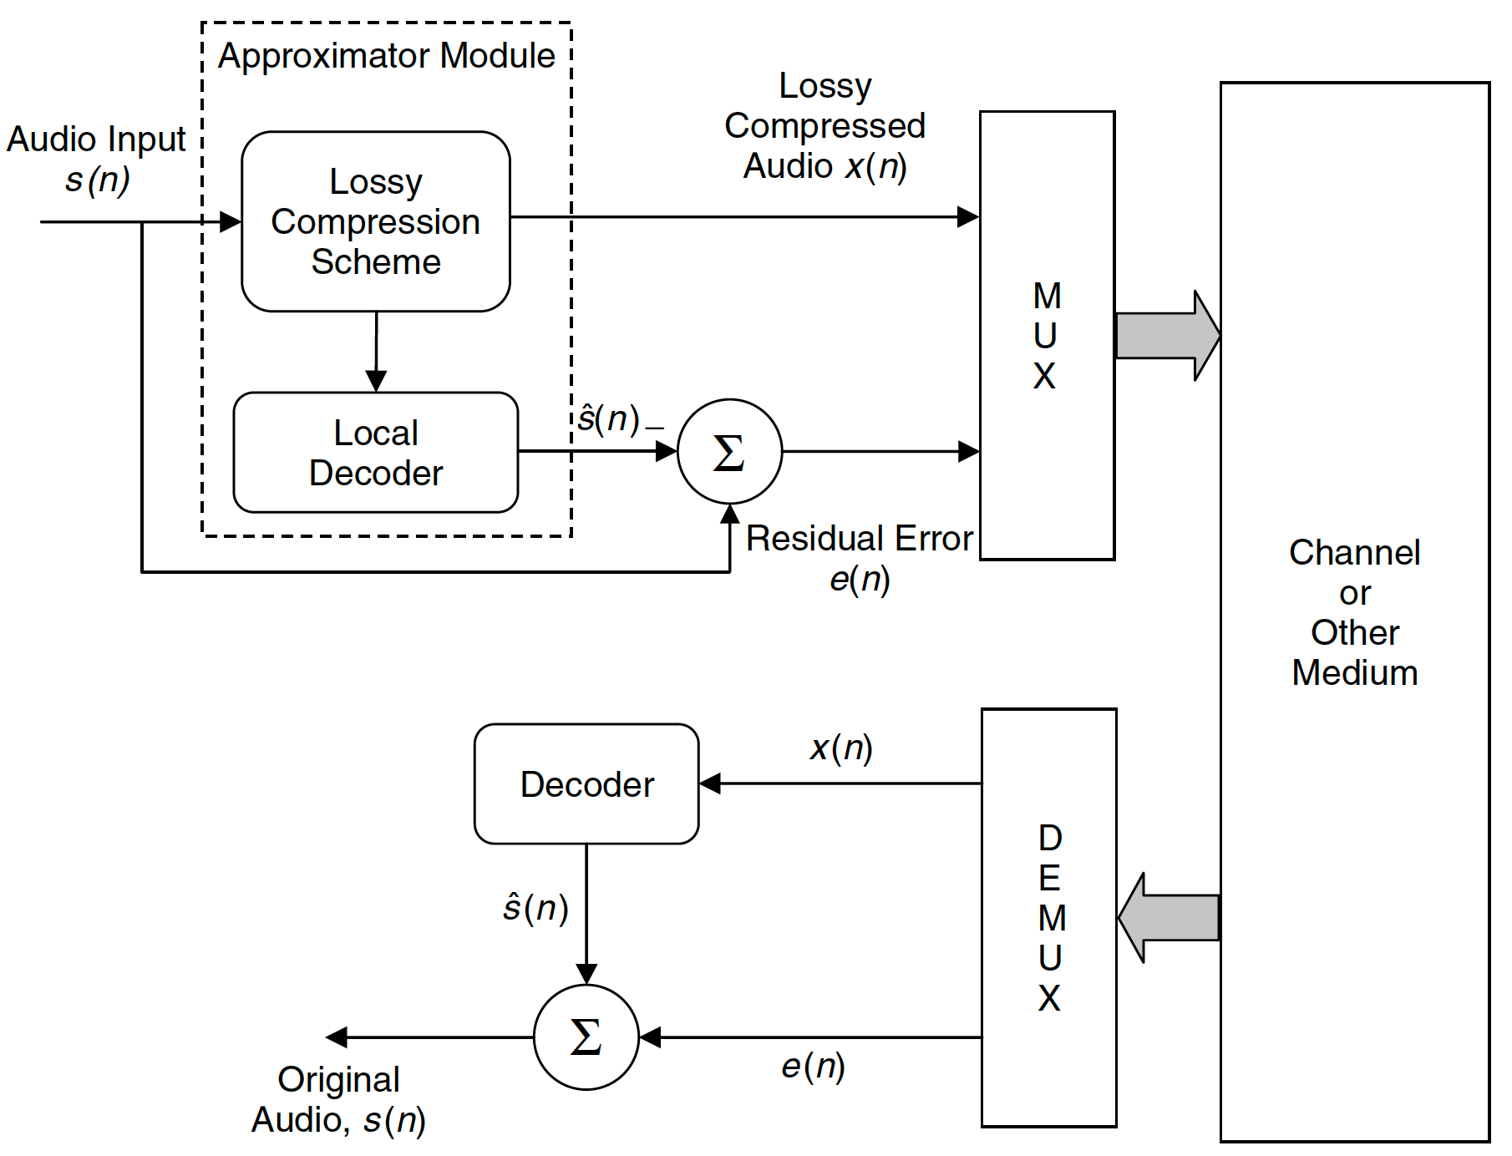
Lossless audio based on lossy audio scheme

Slide 26
References
“Chapter 10: Audio coding standards and algorithms” in Andreas Spanias, Ted Painter, and Venkatraman Atti (2007). Audio Signal Processing and Coding. John Wiley & Sons, Inc.
“Chapter 11: Lossless audio coding and digital watermarking” in Andreas Spanias, Ted Painter, and Venkatraman Atti (2007). Audio Signal Processing and Coding. John Wiley & Sons, Inc.

